Slide 1
TLS 1.3 at a glance
&
Perfect Forward Secrecy

Slide 2
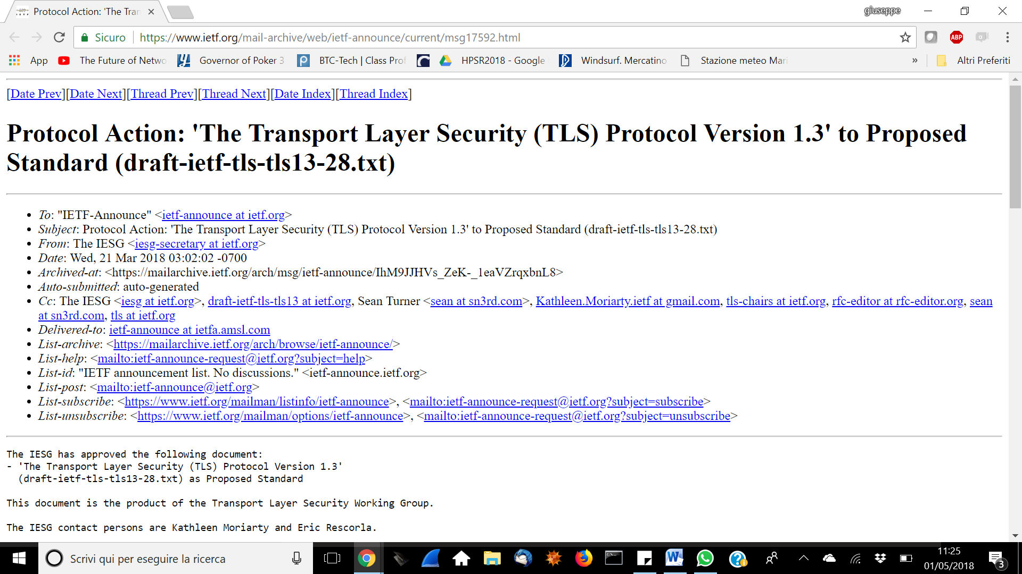
TLS 1.3: Approved in 2018

Slide 3
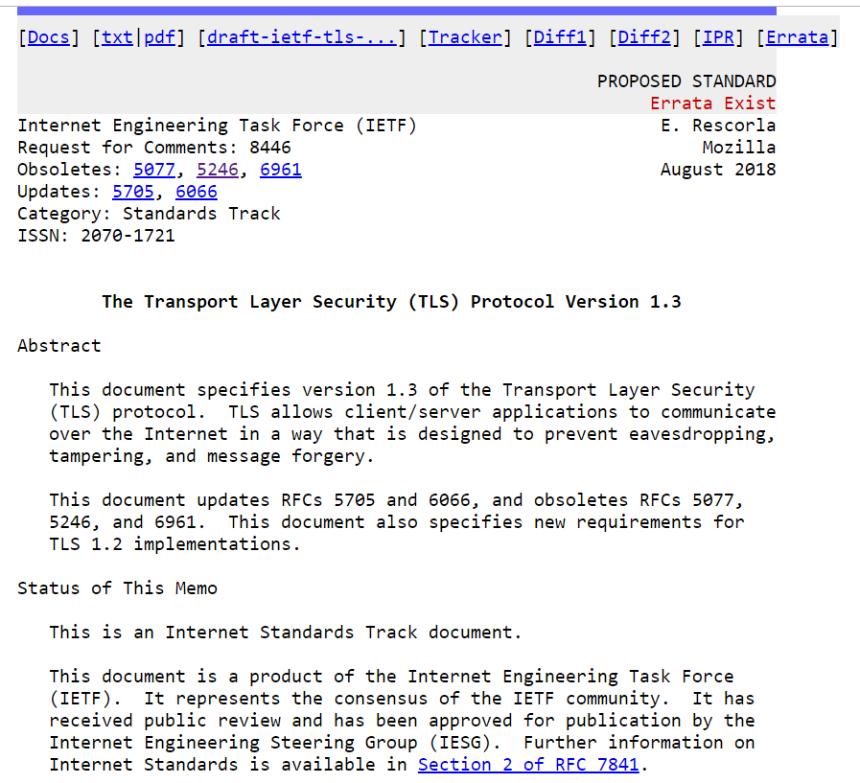
TLS 1.3: Approved in 2018

Slide 4
TLS 1.3: weak ciphers’ pruning
Pruned all symmetric algorithms considered legacy.
  SHA-1, MD5
  RC4, DES, 3DES
  AES-CBC
  (plus a few more technical removals)
What is left?
  ALL (!) remaining ciphers are AEAD (Authenticated Encryption with Associated Data)
    AEAD: no more CCA (Padding Oracle, Lucky 13. etc).
  Notation: TLS_AEAD_HASH (hash used for HKDF):
    TLS_AES_128_GCM_SHA256
    TLS_AES_256_GCM_SHA384
    TLS_CHACHA20_POLY1305_SHA256
    TLS_AES_128_CCM_SHA256
    TLS_AES_128_CCM_8_SHA256

Slide 5
TLS 1.3 handshake
TLS1.2: four pubkey handshake methods supported
  RSA key transport (most common)
  Anonymous Diffie-Hellman
  Fixed Diffie-Hellman
  Diffie-Hellman Ephemeral
TLS1.3: removed all, except one!
  Diffie-Hellman Ephemeral
Why? Forward Secrecy!
  What’s this? See next slides ☺
  But also get rid of RSA issues (Bleichenbacker Oracle, …)

Slide 6
What is perfect forward secrecy?
At the very minimum:
  If a session key is compromised this should NOT compromise data exchanged neither BEFORE nor AFTER.
Actually more than this!
  if a long-term private key (e.g. of the server!!) is compromised at some time, this should also NOT affect data delivered BEFORE such time!
In essence: PFS guarantees that session keys will not be compromised even if long-term secrets used in the session key exchange are compromised

Slide 7
Why PFS is today more and more important?
Protects agains a more powerful attacker model
  Capable of logging huge amount of data
    E.g. a mass-surveillance program capturing all network traffic (remember Snowden…)
  Capable to occasionally break a public/private key pair
    E.g. via a SW bug in the implementation – (remember heartbleed)

Slide 8


Traditional RSA key transport: no PFS!!
pk_{bank}
Hello, let’s talk HTTPS (HTTP over TLS)
sk_{bank}
Here is my public key certificate: {Bank, pk_{bank}}_{CA}
choose
Random
Pre-master secret K
And here is the RSA-encrypted secret key we’ll use in our session: RSA(K)pk_{bank}
Got it:
K
Data exchange: encrypted with symmetric key K

Slide 9
Traditional RSA key transport: no PFS!!
pk_{bank}
Session 12/12/2018: RSA(k1)_{pk}
(--- DATA ---)_{k1}
Session 08/01/2019: RSA(k2)_{pk}
(--- DATA ---)_{k2}
Session 11/05/2019: RSA(k3)_{pk}
(--- DATA ---)_{k3}
Session 09/01/2020: RSA(k4)_{pk}
(--- DATA ---)_{k4}
Session 12/07/2020: RSA(k5)_{pk}
(--- DATA ---)_{k5}
Session 01/04/2021: RSA(k6)_{pk}
(--- DATA ---)_{k6}
Breach 25/11/2021→ sk exposed
Hello, let’s talk HTTPS
sk_{bank}
Here is my public key certificate: {Bank, pk_{bank}}_{CA}
choose
Random
Pre-master secret K
And here is the RSA-encrypted secret key we’ll use in our session: RSA(K)pk_{bank}
Got it:
K
Data exchange: encrypted with symmetric key K

Slide 10
Fixed DH: even worse!!
Fixed
x, g^{x}
Fixed
y, g^{y}
N1_{client ,} g^{x}
N1_{server ,} g^{y}
Data exchange: K1 = HKDF(N1c, N1s, g^{xy})
N2_{client ,} g^{x}
N2_{server ,} g^{y}
Data exchange: K2 = HKDF(N2c, N2s, g^{xy})
→ g^{xy} disclosed!
Breach 25/11/2021→ x (or y) exposed
→ compute K2 (nonces in hello msg)
And all past K!!

Slide 11


Ephemeral Diffie-Hellman: PFS!
Alice
Bob
(PK_{A})_{CA}
(PK_{B})_{CA}
Send Public Key (cert)
to permit verification
SK_{A}
Signature to prevent
MITM attack;
SK_{B}
choose random
x ∈ {0,1}^{s}
choose random
y ∈ {0,1}^{s}
(PK_{A})_{CA} | signed(g^{x})_{A} mod p
(PK_{B})_{CA} | signed(g^{y})_{B} mod p
K= (g^{yx}) mod p
K= (g^{xy}) mod p
Data exchange: encrypted with K
If SK breaks, (ephemeral) session keys are not revealed! Forward Secrecy!
Amd even AFTER breach, if attacker if only passive (but MITM now possible)

Slide 12
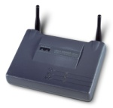
What about PFS vs pre-shared key?
WPA2 key
K = 31EF21456
WPA2 key
K = 31EF21456
Session 1 encrypted with K
Session 2 encrypted with K
We must use same static K… how to get PFS then???
Add an anonymous DH exchange for ephemeral key gen!
g^{x} mod p
g^{y} mod p
Session 3 encrypted with KE = HKDF_{K}(g^{xy})
gª mod p
g^{b} mod p
Session 4 encrypted with KE = HKDF_{K}(g^{ab})
… …

Slide 13


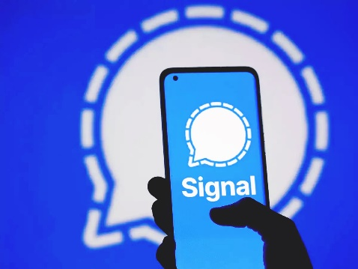
Forward Secrecy & messaging apps
E2e encryption: not even your provider can see
K1
K2
K3
K4
K5
K6
K7
K8
E2e encryption with PFS: Not only your provider cannot see,
But even if it logs all data and gets access later on to your key, he cannot decrypt past messages!
Signal’s Double Ratchet: brilliant solution!

Slide 14
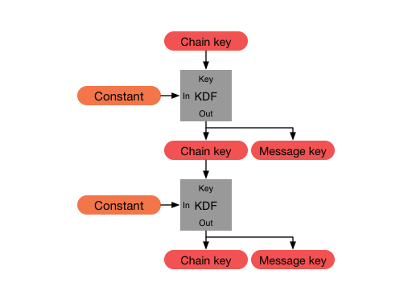
Double ratchet: combines a KDF chain…
Encryption Key change
@ every message!
Symmetric key
Ratchet
Discovering msg Encryption Key does not compromise (past or) future messages
But discovering chain key breaks future security…

Slide 15
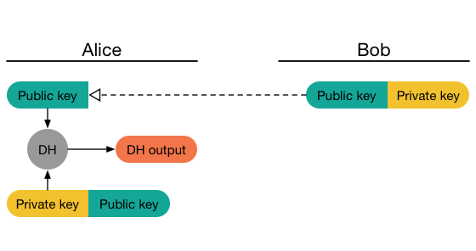
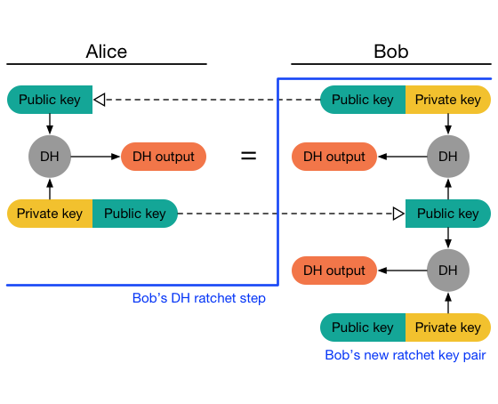
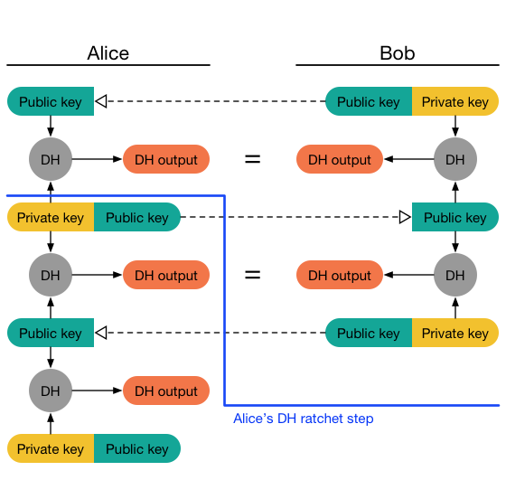
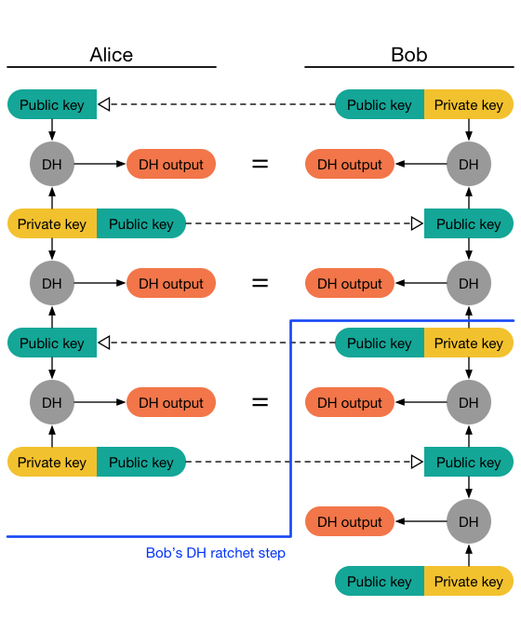
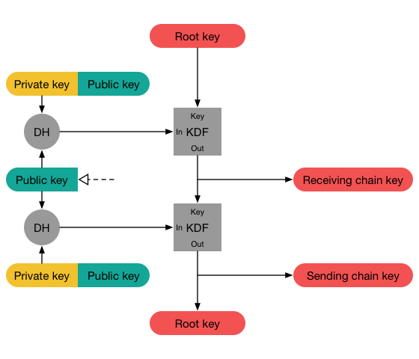
…. With a DH ratchet, to guarantee forward secrecy!
Diffie-Hellman Ratchet
Double ratchet = Sym key ratchet + DH ratchet

Slide 16
TLS 1.3 handshake:
Faster and more secure!
With only DHE left (no more RSA transport):
  3-way handshake versus 4-way! → faster setup
  Perfect forward secrecy
DHE public coefficient g^{x}, Nonce_{c}, ciphersuite offers (and groups)
DHE public coefficient g^{y}, Nonce_{s}, selected mode
Cert request, cert_{s}, signature with cert_{s}, Finished (HMAC)
Already
encrypted!
Cert_{c}, signature with cert_{c}, Finished (HMAC)
Side effect of early encryption: IDENTITY PROTECTION!
(certificates never transmitted in clear)
(not very useful in web, but keep in mind for different TLS scenarios…)

Slide 17
TLS 1.3 handshake:
Further options
Pre-Shared Key
  PSK, already added in TLS 1.2; PSK is either
    Agreed offline in constrained environments
    Computed during the first handshake and then reused in subsequent TSL connections
  New in TLS1.3: optional support for forward secrecy
    Combines pre-shared key with a fresh DHE
DHE public coefficient g^{x}, Nonce_{c}, offer (PSK identity – see tickets in TLSv1.3)
No cert/sign
Necessary anymore!
DHE public coefficient g^{y}, Nonce_{s}, selected mode
Finished (HMAC)
Finished (HMAC)
No cert/sign
Necessary anymore!
Session keys = HKDF(PSK, g^{xy}, etc) → inclusion of g^{xy} guarantees PFS

Slide 18
New handshake structure – wrap-up
CLIENT
Client Hello
SERVER
DH, PSK, extra data, application data if PSK, etc
Server Hello
VERY MUCH DIFFERENT!
3-way handshake
No more change Cipher specs
Handshake encrypted ASAP
Certificate + cert verify both sides
DH key share
Encrypted Certificate + ceryificate verify + finished
Encrypted Certificate + ceryificate verify + finished
Application Data

Slide 19
TLS 1.3 handshake:
Further options
0-RTT Data
  When PSK agreed (in previous handshake), send application data directly in first message
    Use, as key: HKDF_{PSK}(Client-Hello-content)
    i.e. «mix» PSK with new nonce, offer, and client’s DHE public coefficient
  MUCH faster!
    Compelling use case: send HTTP request directly in very first message: saves a full RTT!
    Also, very useful in applications relying on short data transfer
  WAY Less security (obvious replay attack): to be used with care… at your own risk!

Slide 20
Mitigate replay in 0-RTT
Problem: key used in first msg does not include server nonce
Time window mitigation
  Include maximum lifetime after first session
    Standard default = 7 days
  Does not solve… but at least reduces vulnerability period
Control nonce reuse
  Keep a record of all client nonces
  Hard to deploy in large scale systems
    Load balancing, multiple servers, etc…

Slide 21
Other TLS 1.3 nits take home: less is more in security
No renegotiation anymore
  Key Upgrade feature, when rekeying inside same TLS session is required
HKDF officially included
A few simplification in EC management
  Single EC point format, no negotiation
Removal of compression
  What else? Remember CRIME ☺
Exported key [integrates RFC 5705]
  Permits to export to applications a further shared secret key
    Exporter master secret
    Prevents application developers to “invent” their own approach!!
  different and independent from the session master key!

